Slide 1
Azure Account Organization

Slide 2
Azure Hierarchy
Typically 1-2 per contract
Tied to your EA
Can also be Geos, Business Units, etc.
Can view all usage assigned to
Can be departments, project teams, app teams, etc.
Can view all usage underneath it
Use a Service Principle
Where you deploy Azure services
Functions as security and billing container

Slide 3
Roles and Access
Role | Description
Enterprise Administrator | The Enterprise Administrator has the ability to add or associate Accounts and Departments to the Enrolment, can view usage data across all Accounts and Departments, can view the monetary commitment balance associated to the Enrolment. There is no limit to the number of Enterprise Administrators on an Enrolment.
Departments | Departments can be leveraged if an additional level to structure the Accounts and Subscriptions is needed. Costcenter and Start/End date can be added as an attribute to the Department.
Department Administrators | Department Administrators can manage Department properties, manage accounts under the department they administer, download usage details and view monthly Usage and Charges associated to their Department if Enterprise Administrator has granted permission to do so.
Account Owner | The Account Owner can add Subscriptions for their Account, update the Service Administrator and Co-Administrator for an individual Subscription, view usage data for their Account, and view Account charges if the Enterprise Administrator has provided access. The Account Owner will not have visibility of the monetary commitment balance unless they also have Enterprise Administrator rights.
Service Administrator | The Service Administrator and up to nine Co-Administrators per Subscription have the ability to access and manage Subscriptions and development projects within the Azure Management Portal. The Service Administrator does not have access to the Enterprise Portal unless they also have one of the other two roles.

Slide 4
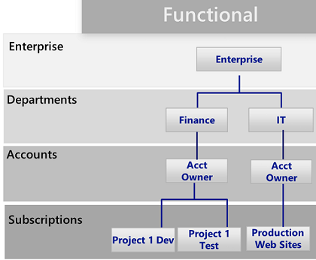
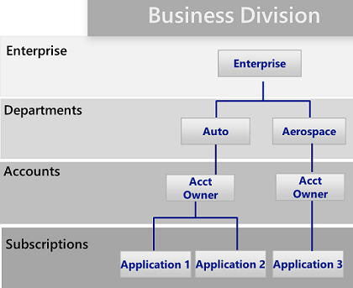
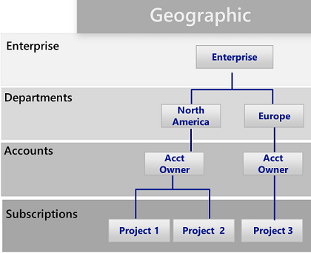
Departments and Accounts

Slide 5
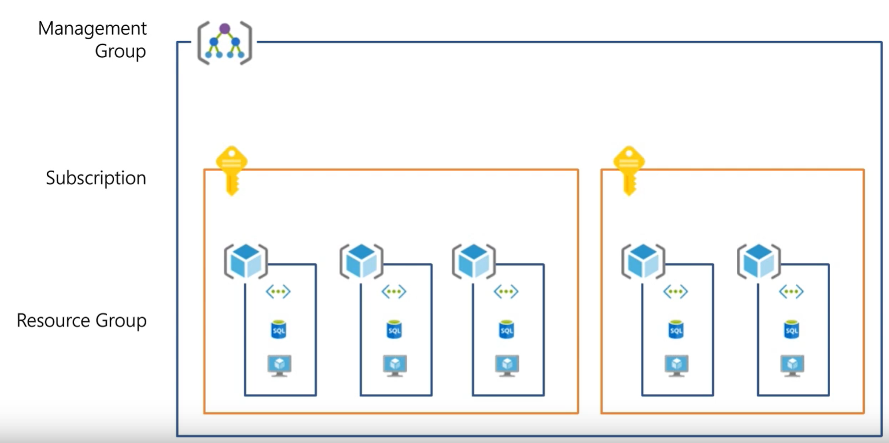
Resource Consistency?
The basic foundation of all governance practices. Achieving the right Governance starts with the correct resource organization.
Management Groups: To reflect security, operations and business/accounting hierarchies
Subscriptions: To group similar resources into logical collections
Resource Groups: To further group applications or workloads into deployment and operations units

Slide 6

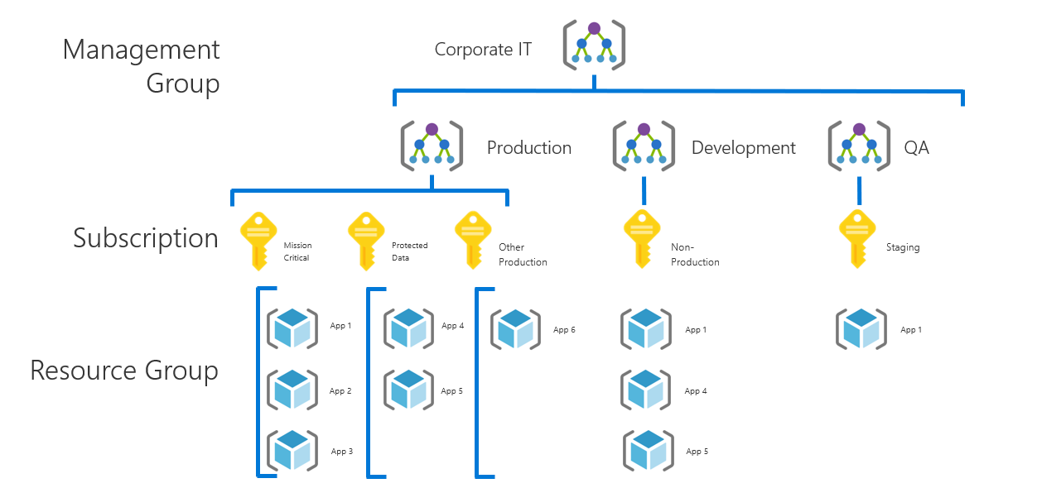
Management Group best practices
Define your hierarchy based on organization and environment type (prod, pre-prod, etc.)
The root MG is for global configuration
Be careful with MG level assignments as they will cascade through large chunks of your hierarchy
Try not to repeat yourself. Assign common policies and RBAC higher up in your hierarchy
Built-in RBAC roles for MGs (MG contributor, MG reader)
Need subscription owner access to move to another MG
Root

Slide 7
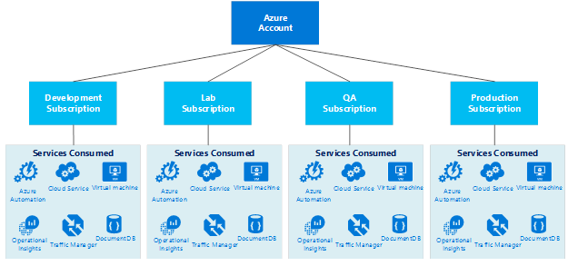
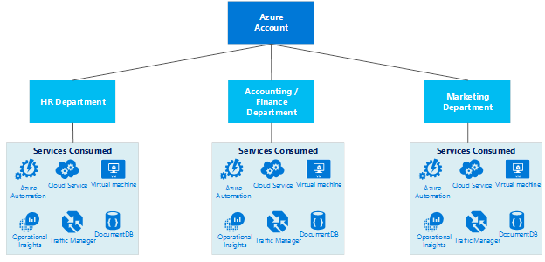
Subscriptions | Design considerations
Develop the Subscription, Network, Storage, Availability and Administrative models together in order to have a cohesive approach.
Service (Process) Design Model
Organizational Unit Design Model
Items to look at when designing the subscription model
Business Requirements
Availability
Recoverability
Performance
Technical Requirements
Network Connectivity (shared or dedicated)
Active directory requirements, clustering, identity, management tools
Security Requirements
Who are the subscription administrators
Least privilege model
Scalability Requirements
Growth plans
Allocation of limited resources
Evolution over time (users, shared access, resource limits)

Slide 8
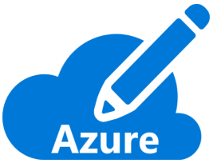
Organize Subscriptions
Ask yourself the following questions:
Are there any capacity / technical limitations?
Do we want to ensure separation of concerns? In example:
Dev/Test Vs. Production
Different end customers
Different departments or business units
Different projects
What is the right naming convention to be used?
i.e.: <Company> <Department (optional)> <Product Line (optional)> <Environment>
Use a dedicated subscription for shared infrastructure (i.e. Azure Active Directory, monitoring & patching tools…). You will be able to spread the cost of this mutualized infrastructure to app owners.
Different departments or business units
Different projects
Notes:
https://docs.microsoft.com/en-us/azure/architecture/best-practices/resource-naming

Slide 9
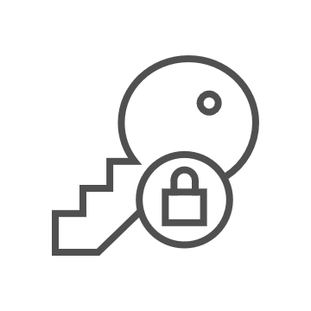
Why scale subscriptions?
Subscriptions have different quota limits for different resource types
At a certain level of usage you will need to create new subscriptions to scale out, so you need to have a strategy for doing so
A very crucial workflow that can slow down a lot of organizations
Some questions you’ll need to answer:
Who will be responsible for creating subscriptions?
What resources will be in a subscription by default?
Subscription A
Subscription B
Subscription C
…

Slide 10




Resource Groups, Tags and RBAC
Finance/Business
Need to be able to break out costs by various dimensions such as Customer, Cost Center, Environment
Create Roles with Appropriate Permissions
Resources in a RG should be tagged as needed
Always Tag!
Owner
Dept.
Environment
Application
(Cost Center)
Best Practices on using Resource Tags: https://azure.microsoft.com/documentation/articles/resource-group-using-tags/
Custom RBAC Roles: https://azure.microsoft.com/documentation/articles/role-based-access-control-custom-roles/
Manage tag governance with Policy: https://docs.microsoft.com/azure/governance/policy/tutorials/govern-tags

Slide 11

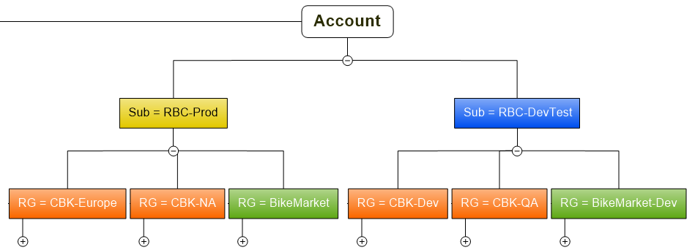
Organize Resource Groups
Important considerations (among others)
All the resources in your group should share the same lifecycle. You deploy, update, and delete them together. If one resource, such as a database server, needs to exist on a different deployment cycle it should be in another resource group.
A resource can interact with resources in other resource groups. This interaction is common when the two resources are related but do not share the same lifecycle (for example, web apps connecting to a database).
A resource group can be used to scope access control for administrative actions.
Example
Two applications; One is running in 2 different regions.
We want to manage the lifecycle of each application

Slide 12
Design the Right Setup
Organize Azure to reflect your organization, not the other way!
Cost transparency:
Set up a cost structure that reflects the actual usage for departments and projects.
Tagging and ownership
Allowed resource types (policy)
Roles and responsibility:
Who has access to what. Account owners and delegations (RBAC)
Minimal access level to carry out the task.
Design for Partners and 3rd parties
Compliance and Security:
Allowed locations e.g. EU (policy)
Network and connectivity (Internet facing, or using the approved VNETS? Policy and NSG)
Continuous Monitoring and integration to existing ITSM (Azure Monitor)

Slide 13
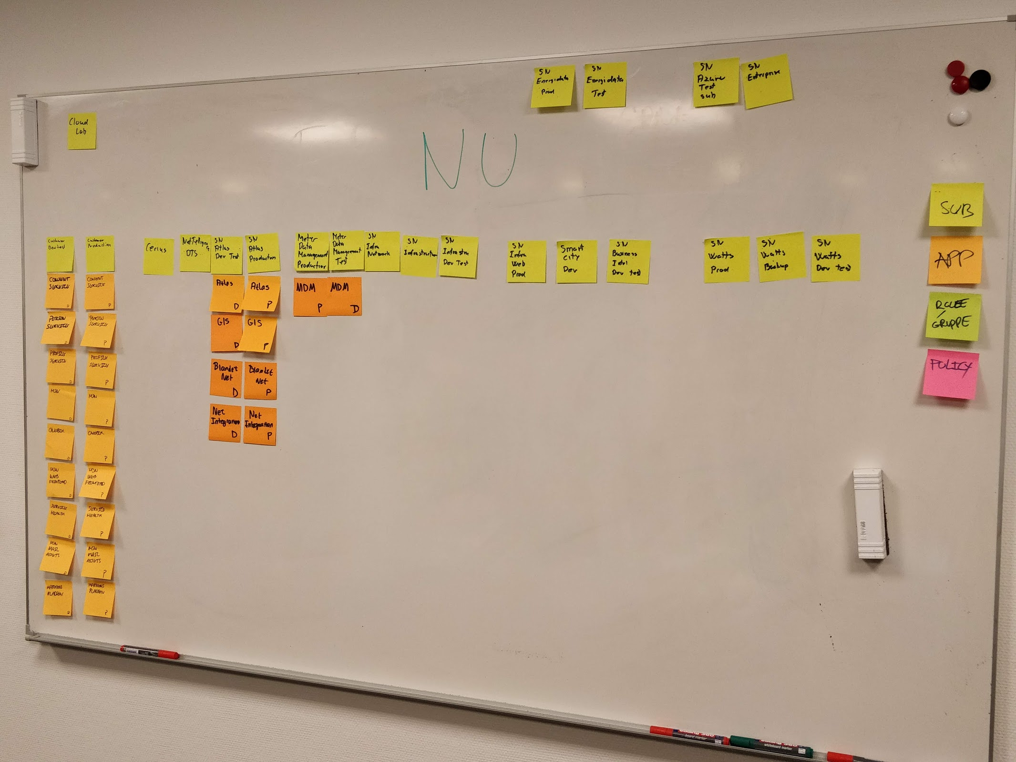
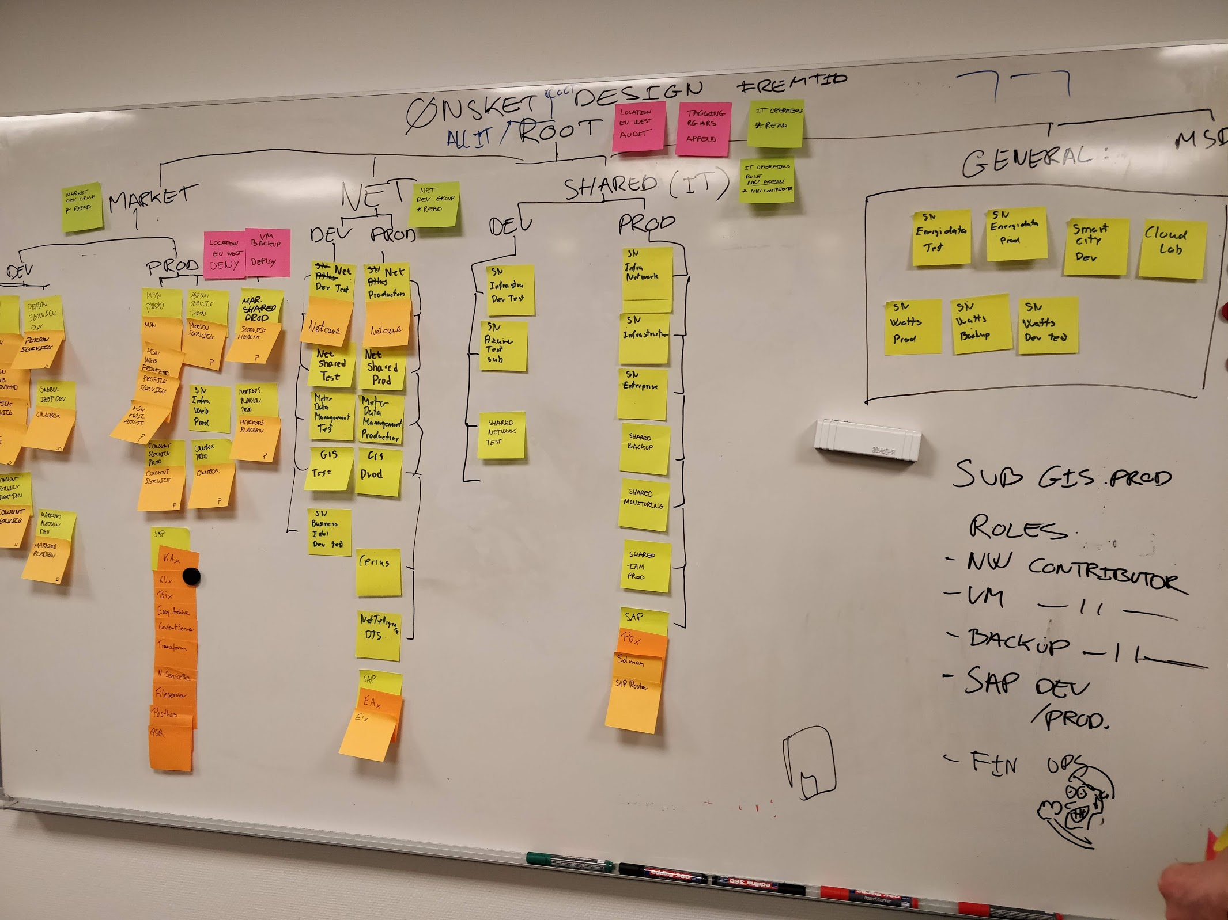
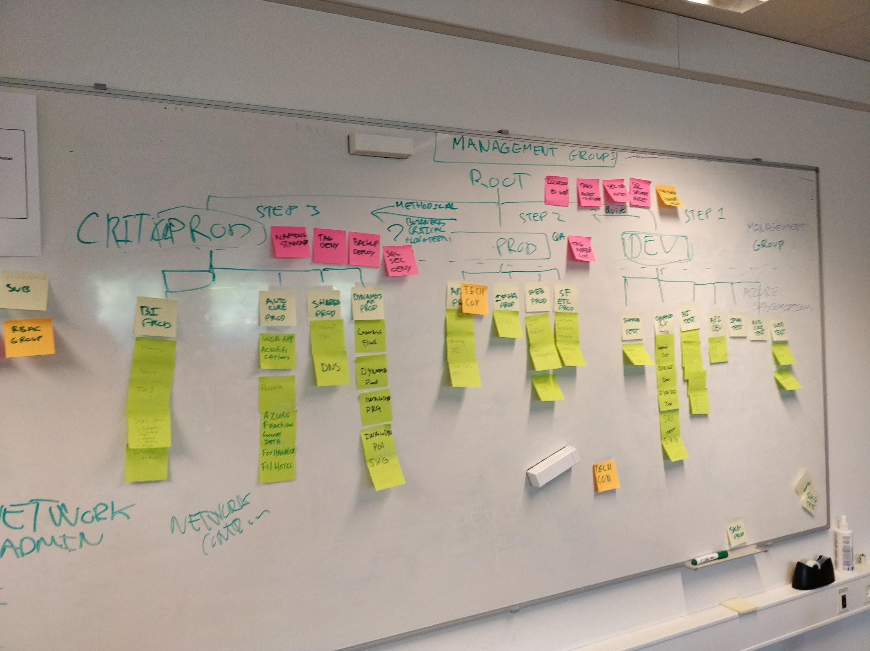
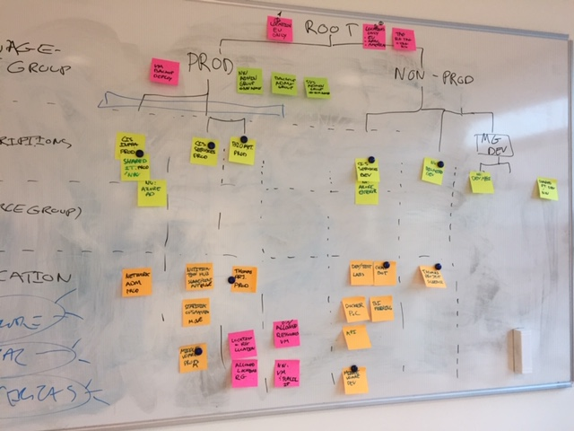
Exercise 1 | Design
Design:
Management groups
Subscriptions
Resource groups
Applications
Policies
Roles and groups
Implement: (Azure portal):
Management groups
Policy
Groups and roles

Slide 14
Exercise 2 | Defining resource policies
What are your current rules for metadata tagging of resources and data?
Who will be responsible for creating subscriptions and management groups?
Will you have different governance rules for specific groups in the company?
What are the regulatory rules you need to adhere to?
How are you monitoring workload health and policy compliance violations?
Classification of mission critical apps and data need to be protected

Slide 15
Sample policies
All deployed assets must be categorized by criticality and data classification.
Subnets containing mission-critical applications must be protected by a firewall solution capable of detecting intrusions and responding to attacks.
Governance tooling must audit and enforce network configuration requirements defined by the Security Management team.
Governance tooling must validate that all assets related to mission-critical apps or protected data are included in monitoring for resource depletion and optimization.
Governance tooling must validate that the appropriate level of logging data is being collected for all mission-critical applications or protected data.
Governance process must validate that backup, recovery, and SLA adherence are properly implemented for mission-critical applications and protected data.

Slide 16
Build the Cost Management

Slide 17

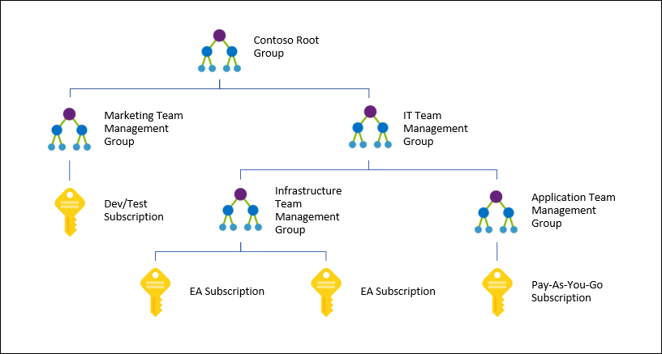

Let’s outline cost management
Continuous cost optimization process
Optimization
MG to govern tags Used as a cost scope for budget and Cost Analysis
Tags for visibility cross scopes
Monitor
Accountability
Management teams
Finance teams
App teams

Slide 18
Azure Cost Management
Management Groups
Tags
Action Groups
Cost Management in Azure
Always on by default, no setup needed
Data hygiene for tags and policies
Optimize through Azure Advisor
Notifications through action groups
RBAC and management groups ensures better access controls
Manage AWS costs and usage in Azure
RBAC
Advisor
ACM
ARM
Policy
Notes:
A major benefit of having cost management in the Azure Portal is that now you can take advantage of deep integration with a variety of Azure services that make your experience even better.
You can take advantage of policy to help you with tagging you resources and be able to do better cost analysis.
Azure management groups and RBAC allow you to ensure better access controls to your data
Implement notifications through action groups, which will help with budgets
Azure Advisor is now integrated in Azure Cost Management too, giving you suggestions on how to optimize your workloads through things like right sizing, reserved instances or eliminating idle resources.
This is the power of being part of the Azure platform.
built on top of ARM,
RBAC

Slide 19
Cost management solutions for a variety of needs
Cost Management
in Azure Portal
Connectors to PowerBI
Azure APIs
Ready to use
Custom dashboards
Custom solutions
Notes:
Azure Cost Management is a ready to go service, but we understand that you may want to customize your cost management experience and that is why we are providing connectors for PowerBi and access to the cost management APIs.
Now you can customize your own dashboard on PowerBI, and use the APIs to integrate it with your existing applications.
With Azure Cost Management, we want to make sure that we provide al the tools necessary for your needs and that is why we cover this spectrum.

Slide 20
Exercise | Defining cost policies
How are you landing accountability of budget?
Are you going to allow the use of any Azure service / resource?
What are the policies around budget over-run?
What is the cadence in the business to set, review, adjust and optimize on budgets?
Will there be different policies for spend based on internal use or a potential to impact customer experience?
Notes:
Billing tags policy initiative - https://docs.microsoft.com/en-us/azure/governance/policy/samples/billing-tags-policy-initiative

Slide 21
Sample policies
Append CostCenter Tag & Its value from Resource Group
Append CostCenter Tag to Resource Groups
For tracking purposes, all assets must be assigned to an application owner within one of the core business functions.
When cost concerns arise, additional governance requirements will be established with the finance team.

Slide 22
Build the Security Baseline

Slide 23
What is Security Baseline?
The Security Baseline discipline focuses on ways of establishing policies that protect the network, assets, and most importantly the data that will reside on a cloud provider's solution.

Slide 24


The cloud kill chain model
Exposure
Access
Lateral movements
Actions
Insecurely configured applications
Virtual machines
Web apps
Data loss
Vulnerabilities
Web apps
SQL databases
Data exfiltration
Infected admin
Credentials
Virtual machines
Brute force attacks
Notes:
When attacking cloud infrastructure, adversaries often attack multiple resources to try to obtain access to customer data or company secrets. The cloud kill chain model explains how attackers attempt to gain access to any of your resources running in the public cloud through a four-step process: exposure, access, lateral movement, and actions.
Exposure is where attackers look for opportunities to gain access to your infrastructure. For example, attackers know customer-facing applications must be open for legitimate users to access them. Those applications are exposed to the Internet and therefore susceptible to attacks. Attackers will attempt to attack vulnerabilities or exploit weak credentials in the exposed applications. Exposure can also be found in vulnerabilities or malware-based attacks to compromise user credentials.
Attackers will try to exploit an exposure to gain access to your public cloud infrastructure. This can be done through compromised user credentials, compromised instances, or misconfigured resources. With compromises instances, attackers can gain access to instances by exploiting a vulnerability, such as on a publicly facing web application or exploiting weak credentials, such as brute forcing a publicly facing SSH server. Without security controls in place, 68% of breaches take months or longer to discover.
During the lateral movement stage, attackers discover what resources they have access to and what the scope of that access is. Successful attacks on instances give attackers access to databases and other sensitive information. The attacker then searches for additional credentials. Without a security tool to quickly notify you of the attack, it takes organizations on average 101 days to discover a breach. Meanwhile, in just 24-48 hours after a breach, the attacker will usually have complete control of the network.
The actions an attacker takes after lateral movement are largely dependent on the resources they were able to gain access to during the lateral movement phase. Attackers can take actions that cause data exfiltration, data loss or launch other attacks. For enterprises, the average financial impact of data loss is now reaching $1.23 million.

Slide 25
Manage organizational security policies and assess compliance in minutes
Highly Dynamic Environment
Manage security policies at an organizational level
Easily set security policies for subscriptions or management groups
Instantly understand your current policy compliance and review compliance overtime
!
!
!
!
!
New machine
without AV
PCI Non-compliance
Unencrypted SQL server
Insecure Subnet
Remote connection left open

Slide 26
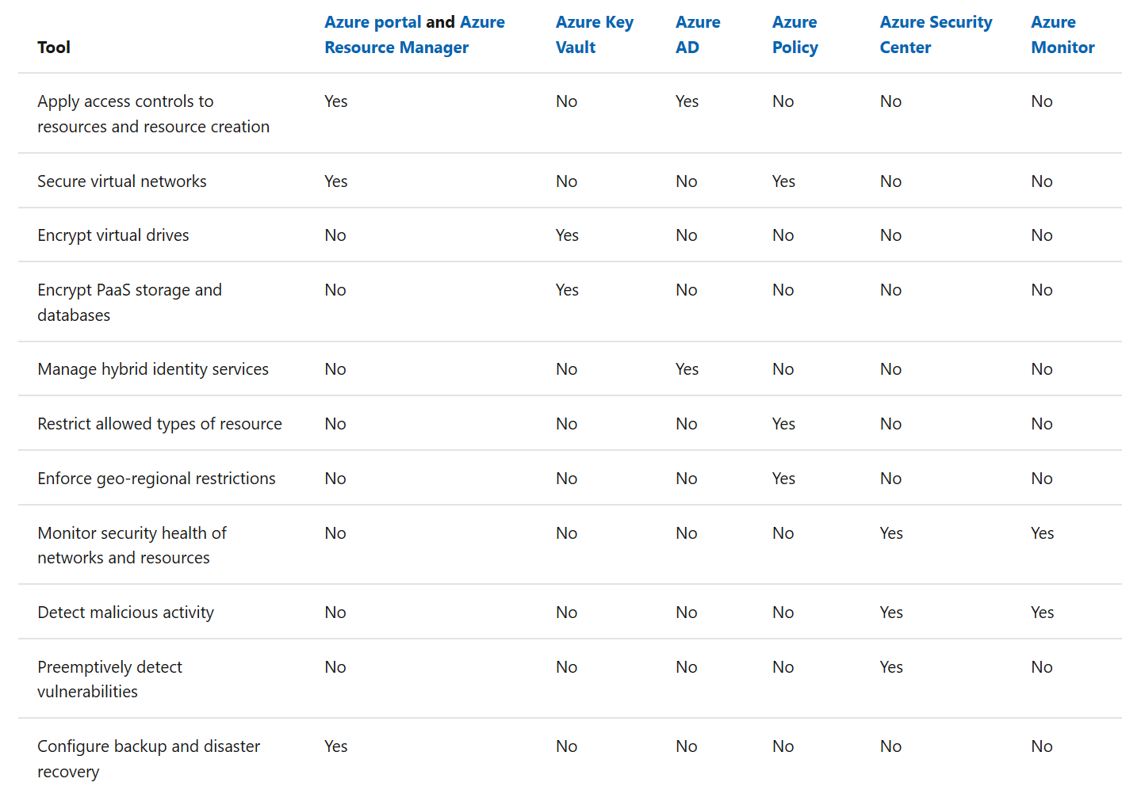
Security baseline tools in Azure
The following list of Azure tools can help mature the policies and processes that support Security Baseline.
For a complete list of Azure security tools and services, see Security services and technologies available on Azure.

Slide 27
Exercise | Defining security baseline policies
How are you addressing asset classification?
What are the data encryption rules?
How are you preventing data leaks?
Are you isolating your networks to prevent data leaks?
What is the policy around external access to public data?
We need to ensure that we protect from DDoS attacks
How are you monitoring and remediating against configuration changes?
Need to ensure that there is an ongoing security review.

Slide 28
Sample policies
All deployed assets must be categorized by criticality and data classification. Classifications must be reviewed by the cloud governance team and the application owner before deployment to the cloud.
All protected data must be encrypted when at rest.
Network subnets containing protected data must be isolated from any other subnets. Network traffic between protected data subnets is to be audited regularly.
All connections between the on-premises and cloud networks must take place either through a secure encrypted VPN connection or a dedicated private WAN link.

Slide 29
Build the Identity Baseline

Slide 30
Role Based Access Control
SUBSCRIPTION
CONTRIBUTORS
OWNER
READERS
RESOURCE GROUPS
CONTRIBUTORS
OWNER
READERS
RESOURCES
CONTRIBUTORS
OWNER
READERS

Slide 31
Workshop | Defining identity baseline policies
Do you have a consistent way of applying access control?
When you apply access control how are you thinking about the roles and functions aligned to users work?
Have you done the mapping of on-premise roles to the cloud roles to ensure cloud resources can perform necessary functions
Are you planning on using multi-factor authentication?
As your teams build apps you need to ensure that you have compatible identity providers for customer authentication.

Slide 32
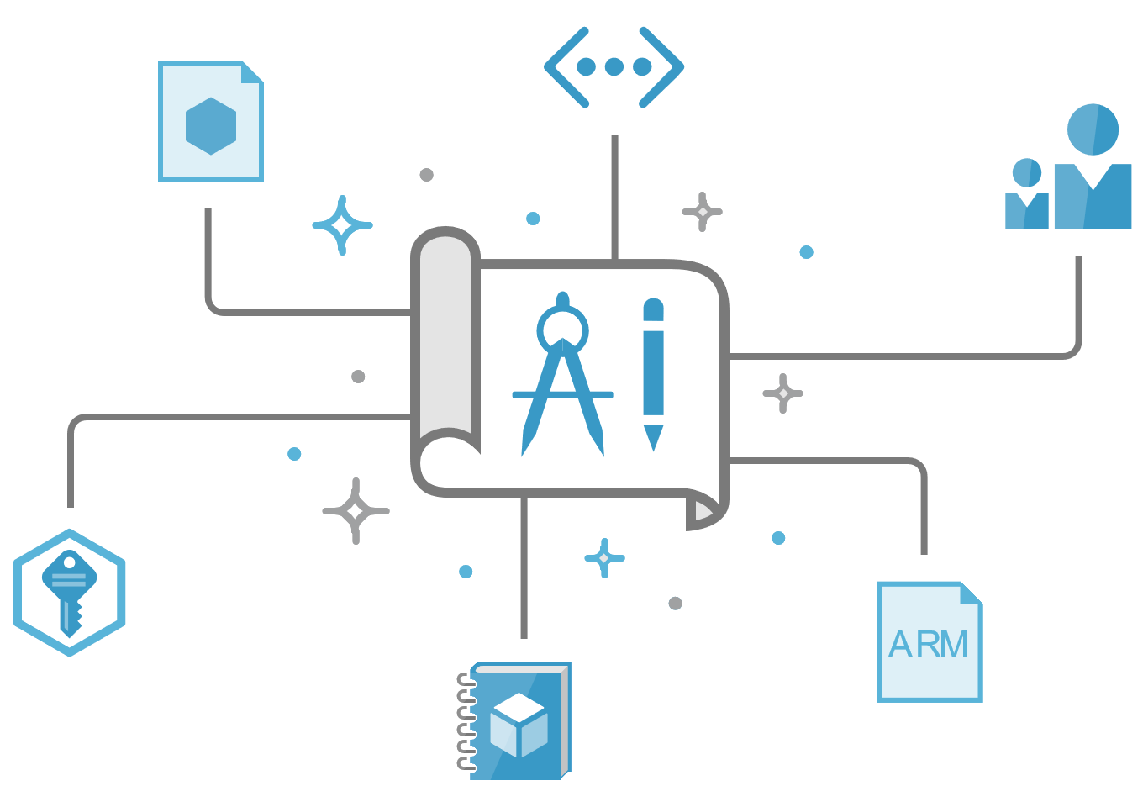

Introducing Azure Blueprints solution
automated, easy-to-deploy solution to help setup governed Azure Subscriptions
Compose
Orchestrate
Protect
Empower
Let app teams use Azure in a self-service manner while ensuring organizational standards
Compose, deploy and update cloud environments in a repeatable manner
Orchestrate deployment of Resource Templates, Policies, and RBAC
Lock down foundational infrastructure that are shared across subscriptions
Notes:
It’s a tracked entity.

Slide 33


Azure Blueprints
Role-based access controls
deploy and update cloud environments in a repeatable manner using composable artifacts
Policy Definitions
Management groups
ARM Templates
Subscription A
Azure Blueprints
Subscription B
Resource Groups
Subscription C
…
compose
manage
scale

Slide 34
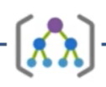
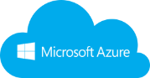



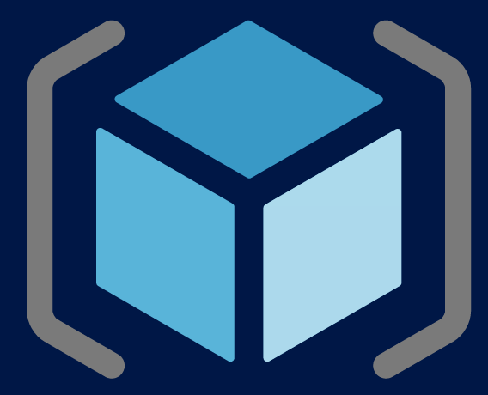
How it works
1
Contoso Blueprint
Creates a Blueprint
Cloud Engineer
Cloud Engineer
2
Policies
Adds artifacts (azure resources) to be used
Networking
4
Apply Blueprint to Scope (MG, Sub)
RBAC
3
Identifies artifacts to be instantiated by default
Functions\Runbooks
Curated Marketplace
Other Templates
Deployed foundational artifact

Slide 35
Customer requested scenarios
Cost Visibility per Blueprint: Ability to view cost of Blueprint managed resources
Sub creation with Blueprint deployment: Ability to create subscriptions while assigning a Blueprint (increase the 50subs per account limit)
Integrate Blueprint assignment in sub creation experience: Ability to pick a Blueprint in the subscription creation portal experience.

Slide 36


Security Center Architecture
Threat
Intelligence
Azure
Network & PaaS Netflow, SQL DB and Storage Logs, …
Azure Security Center
Security analytics
Threat Detections, Prescriptive Recommendations
Security Dashboards Deliver Rapid Insights into Security State Across All Workloads
Security Dashboards Deliver Rapid Insights into Security State Across All Workloads
Windows & Linux agents
Windows Events, Syslog, CEF, Configurations
Normalization & enrichment IP Geotagging, …
Actionable Security Recommendations
Curated, Prioritized Security Alerts
On-premises, private and public clouds
Scalable Log Analytics Platform
Investigation Tools and Log Search
Export to Excel and Power BI
REST APIs
Automation
Notifications

Slide 37

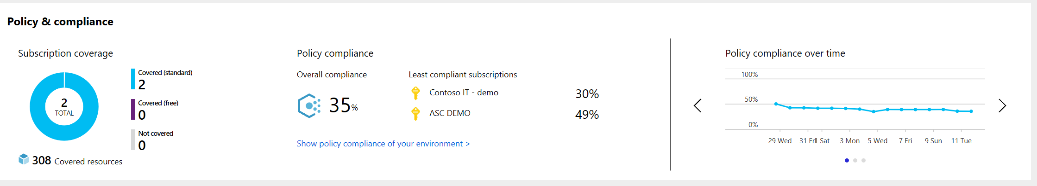
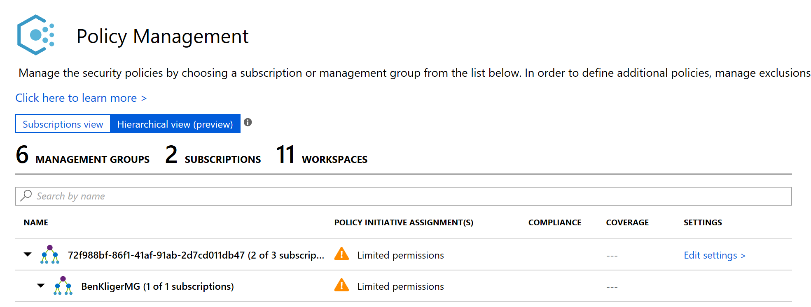
Manage organizational security policy and compliance
Review coverage for Azure Security Center across different subscriptions
Easily set centralized security policies across multiple subscriptions
Track and review policy compliance and governance over time
Notes:
Coverage
Helps the organization identify “ShadowIT” subscriptions and ensures you gain visibility into their security posture by enabling ASC, as well as security coverage
Identify subscriptions that are not protected at all, or do not have sufficient coverage level (e.g. ASC free instead of standard

Slide 38

Protect against threats
Detect and block advanced malware and threats for servers
Detect threats across IaaS and PaaS services using advanced analytics
Reduce exposure to brute force attacks
Azure Security Center
Protect data services against malicious attacks

Slide 39
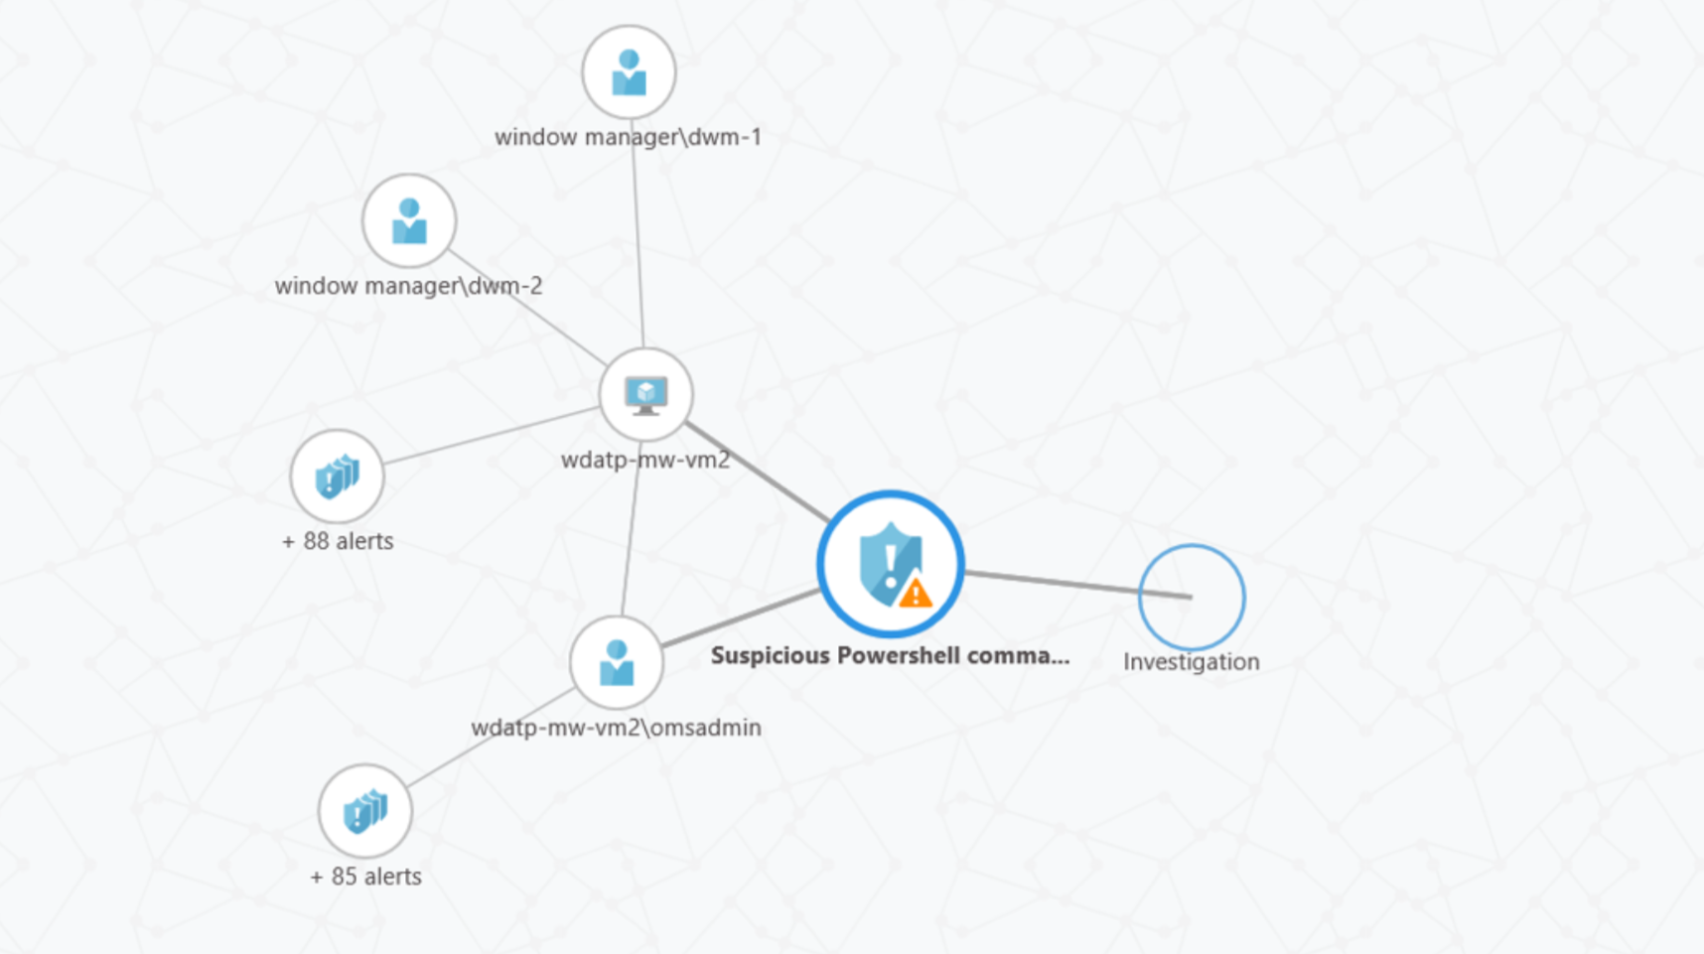
Detect and block advanced malware for Windows and Linux servers
Detect threats on servers with behavior analytics and machine learning
Get Windows server EDR with the integration of Windows Defender ATP
Automate application whitelisting with a ML based solution
Notes:
WDATP:
Windows Server Endpoint Detection and Response
Protects against zero-day malware and other server threats
post-breach detection
Automatic enablement for Azure and on-premises Windows Servers
Spot attacks and zero-day exploits using advanced behavioral analytics and Machine Learning
Adaptive application controls:
Use Adaptive Application Controls to harden your VMs against unknown malware
Adaptive whitelisting learns application patterns
Simplify management with recommended whitelists
Talk about Hybrid

Slide 40
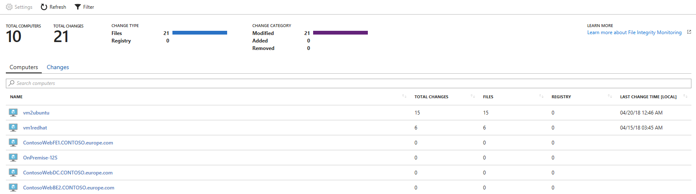
File integrity monitoring
Examines files and registries of the operating system, application software, and others for changes that might indicate an attack
Validates the integrity of Windows files, Windows registry, and Linux files.
Select the files that you want to be monitored by enabling File Integration Monitoring (FIM)

Slide 41
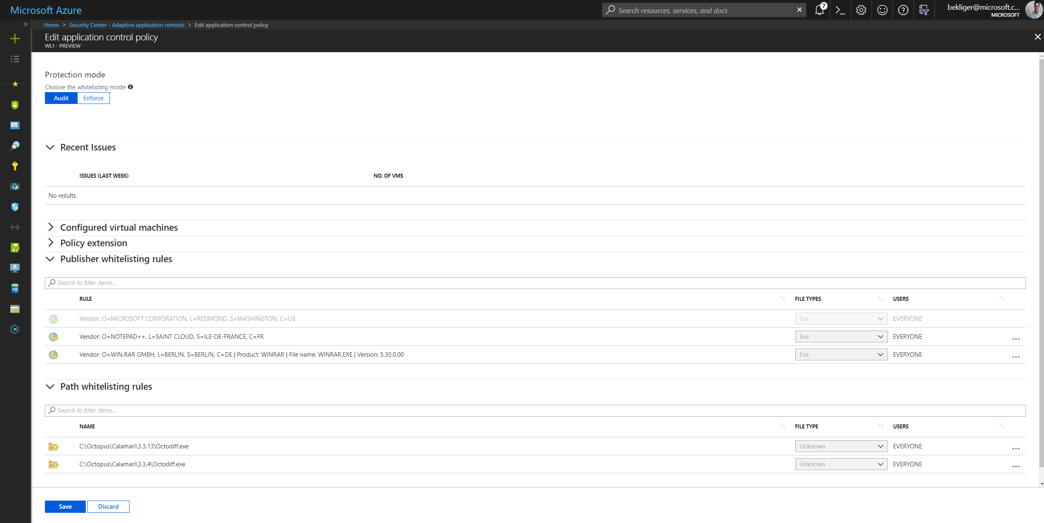
Adaptive application controls
Control which applications can run on your VMs located in Azure with Adaptive Application Controls to help harden your VMs against malware
Adaptive whitelisting learns application patterns
Simplify management with recommended whitelists

Slide 42
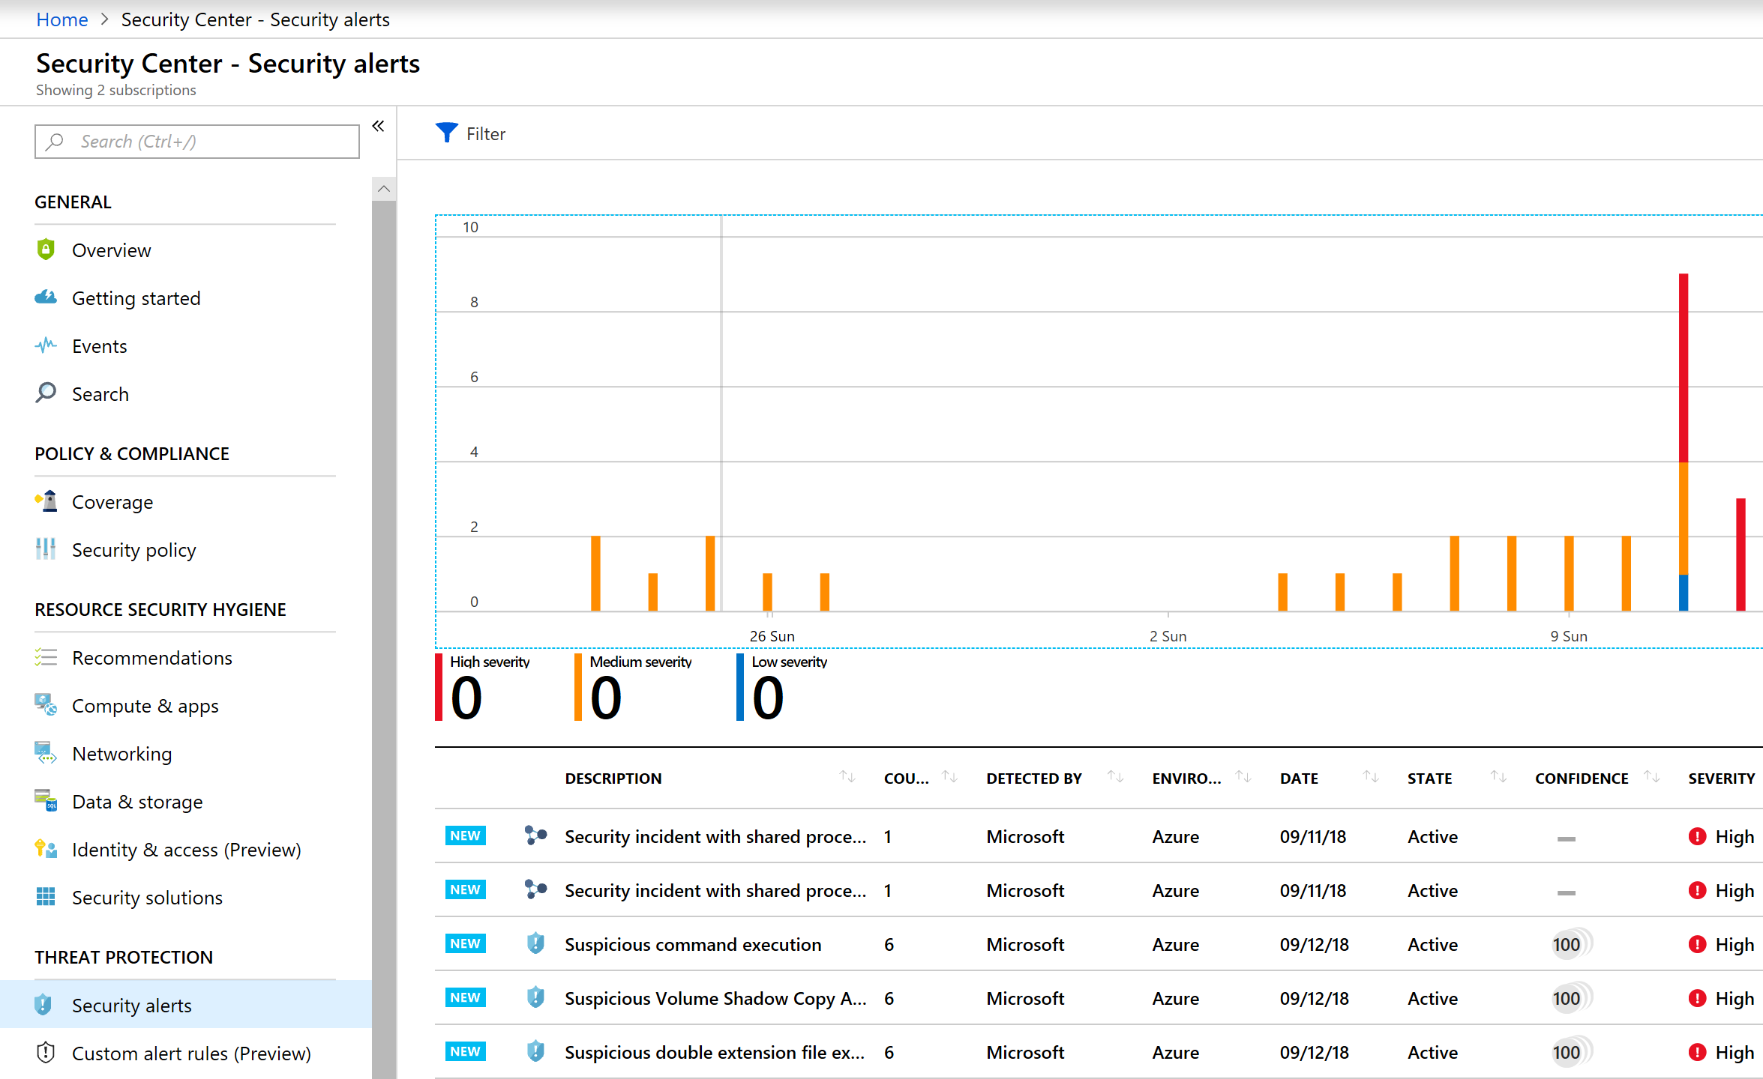
Detect threats across services
Detect threats targeting Azure services such as Azure App Services, Azure SQL, Storage services and more
Get Azure UEBA with the integration of Microsoft Cloud App Security
Investigate and respond to an attack with ASC Fusion kill chain analysis
Notes:
See prioritized security alerts and incidents

Slide 43
Detect threats across services using advanced analytics
Threat intelligence- looks for known malicious actors using Microsoft global threat intelligence
Advanced analytics- use anomaly detection and behavioral analytics to detect malicious behaviors
Fusion- automatically correlating events and alerts from across the kill chain to map an attack campaign
Windows server EDR- integrated solution with Windows Defender ATP

Slide 44
Appendix

Slide 45
Common policies
Enforce tag and its value on resource groups Allowed locations Allowed resource types Not allowed resource types Not allowed VM Extensions Audit VMs with insecure password security settings Allowed SKUs for Storage Accounts and Virtual Machines Approved VM images Audit when VM does not use Managed Disk Deploy network watcher when virtual networks are created | Audit SQL Server audit settings Audit SQL Database encryption Ensure https traffic only for storage account Ensure storage file encryption Enable Monitoring in Azure Security Center Network interfaces should not have public IPs Deployment Locations Disk encryption should be applied on virtual machines Secure transfer to storage accounts should be enabled
Notes:
Policies - Common
GitHub Policy Samples
https://github.com/Azure/azure-policy/tree/master/samples
General
Resource Groups
*** Need to test: https://github.com/sympa18/CheckandApplyTags
https://docs.microsoft.com/en-us/azure/governance/policy/samples/enforce-tag-on-resource-groups
Locations
https://docs.microsoft.com/en-us/azure/governance/policy/samples/allowed-locations
Resource Types
https://docs.microsoft.com/en-us/azure/governance/policy/samples/not-allowed-resource-types
Billing tags policy initiative
https://docs.microsoft.com/en-us/azure/governance/policy/samples/billing-tags-policy-initiative
Compute
https://docs.microsoft.com/en-us/azure/governance/policy/samples/allow-custom-vm-image
https://docs.microsoft.com/en-us/azure/governance/policy/samples/allowed-skus-storage
https://docs.microsoft.com/en-us/azure/governance/policy/samples/allowed-custom-images
https://docs.microsoft.com/en-us/azure/governance/policy/samples/use-managed-disk-vm
Data Lake
https://docs.microsoft.com/en-us/azure/governance/policy/samples/enforce-data-lake-store-encryption
Linux
https://docs.microsoft.com/en-us/azure/governance/policy/samples/guest-configuration-applications-installed-linux
Key Vaults
https://docs.microsoft.com/en-us/azure/governance/policy/samples/keyvault-no-vnet-rules
Monitoring
https://docs.microsoft.com/en-us/azure/governance/policy/samples/audit-diagnostic-setting
Network
https://docs.microsoft.com/en-us/azure/governance/policy/samples/audit-diagnostic-setting
https://docs.microsoft.com/en-us/azure/governance/policy/samples/network-watcher-not-enabled
SQL
https://docs.microsoft.com/en-us/azure/governance/policy/samples/sql-server-audit
https://docs.microsoft.com/en-us/azure/governance/policy/samples/audit-sql-server-audit-setting
https://docs.microsoft.com/en-us/azure/governance/policy/samples/sql-database-encryption-audit
https://docs.microsoft.com/en-us/azure/governance/policy/samples/audit-sql-db-audit-setting
Storage
https://docs.microsoft.com/en-us/azure/governance/policy/samples/ensure-https-storage-account
https://docs.microsoft.com/en-us/azure/governance/policy/samples/ensure-storage-file-encryption
Built In Policies
Enable Monitoring in Azure Security Center
Audit VMs with insecure password security settings
Enable Azure Monitor for VMs
Audit Windows VMs that are not joined to the specified domain
Audit Windows VMs that contain certificates expiring within the specified number of days
Network interfaces should not have public IPs
Deployment Locations
Audit virtual machines without disaster recovery configured
Deploy Log Analytics Agent for Linux VMs
There should be more than one owner assigned to your subscription
Disk encryption should be applied on virtual machines
Automation account variables should be encrypted
Secure transfer to storage accounts should be enabled
Add or replace a tag on resources
Deprecated accounts should be removed from your subscription
Require specified tag
The Log Analytics agent should be installed on virtual machines
Deploy network watcher when virtual networks are created
Advanced data security should be enabled on your SQL servers
Advanced data security should be enabled on your SQL managed instances
Just-In-Time network access control should be applied on virtual machines
Activity log should be retained for at least one year
Only approved VM extensions should be installed
Inherit a tag from the resource group
Diagnostic logs in Key Vault should be enabled
Inherit a tag from the resource group if missing
Vulnerabilities on your SQL databases should be remediated

Slide 46
Where to go for more information
Azure Cost Management product page
https://azure.microsoft.com/services/cost-management/
Azure Cost Management documentation
https://docs.microsoft.com/azure/cost-management/
Azure Cost Management API reference
https://docs.microsoft.com/rest/api/cost-management/
FastTrack for Azure (deployment guidance)
https://azure.microsoft.com/programs/azure-fasttrack/
Twitter @AzureCostMgmt

Slide 47
Azure CAF Tooling
Implement Corporate Policies: Azure Policy
Apply Policies across subscriptions: Azure Management Groups
Create fully compliant environments: Azure Blueprints
Create an automated pipeline to deploy code and configure assets (DevOps): Azure DevOps

Slide 48
Azure Resources
Microsoft Cloud Adoption Framework for Azure https://docs.microsoft.com/en-us/azure/architecture/cloud-adoption/
Ensure the environment is prepared for the cloud adoption plan
https://docs.microsoft.com/en-us/azure/architecture/cloud-adoption/ready/
Azure readiness guide
https://docs.microsoft.com/en-us/azure/architecture/cloud-adoption/ready/azure-readiness-guide/
Azure Quickstart Center
https://docs.microsoft.com/en-us/azure/azure-portal/azure-portal-quickstart-center
Cloud rationalization
https://docs.microsoft.com/en-us/azure/architecture/cloud-adoption/digital-estate/5-rs-of-rationalization
Azure migration best practices
https://docs.microsoft.com/en-us/azure/architecture/cloud-adoption/migrate/azure-best-practices/

Slide 49
Azure Resources
Management Groups & Subscription Management
https://docs.microsoft.com/en-us/azure/cloud-adoption-framework/ready/considerations/scaling-subscriptions
https://docs.microsoft.com/en-us/azure/governance/management-groups/
Blueprints
https://docs.microsoft.com/en-us/azure/governance/blueprints/overview
https://docs.microsoft.com/en-us/azure/governance/blueprints/samples/
https://docs.microsoft.com/en-us/azure/governance/blueprints/create-blueprint-rest-api
Compute Decisions
https://docs.microsoft.com/en-us/azure/architecture/cloud-adoption/ready/considerations/compute-decisions
Naming Standards
https://docs.microsoft.com/en-us/azure/architecture/best-practices/resource-naming
https://docs.microsoft.com/en-us/azure/cloud-adoption-framework/ready/considerations/naming-and-tagging
https://docs.microsoft.com/en-us/azure/governance/policy/samples/enforce-like-pattern
Enterprise Dev/Test
https://azure.microsoft.com/en-us/offers/ms-azr-0148p/
https://azure.microsoft.com/en-us/pricing/dev-test/
Cloud Adoption Framework - DevOps Project Template
https://azuredevopsdemogenerator-staging.azurewebsites.net/environment/createproject
MS Learn
https://docs.microsoft.com/en-us/learn/
Security
https://docs.microsoft.com/en-us/azure/security/

